Slide 1
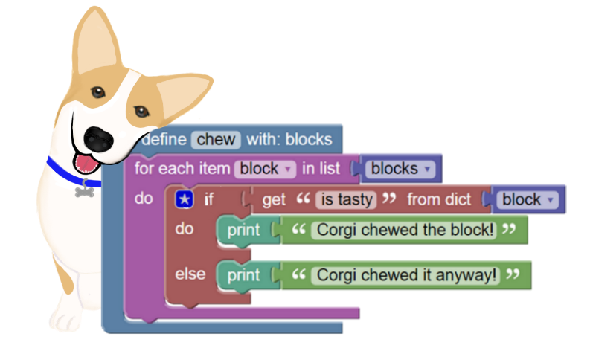
BlockPy
A Dual Block/Text Programming Environment for Python
Austin Cory Bart, Javier Tibau, Luke Gusukuma,
Dennis Kafura, Clifford A. Shaffer, Eli Tilevich
Virginia Tech and EPSOL
Special Thanks to Google Blockly, the Skulpt project, and the National Science Foundation under Grants DGE-0822220, DUE-1444094, and DUE-1624320
Notes:
Hello, today I’d like to introduce you to new a web-based coding environment named BlockPy.
BlockPy is a free, open-source project to make it easier for people to learn how to program in Python. BlockPy has a number of powerful features that scaffold learners into more mature environments.

Slide 2
Major BlockPy Features
Dual Block/Text Interface
Client-side Python execution
Data Science Tools
Guided Practice Problems
LTI Integration
Notes:
In this video, I am going to review a number of the most interesting features of BlockPy.
First, we’ll look at the dual block/text interface. Next, we’ll check out BlockPy’s Python execution system named Skulpt. Then we’ll take a look at the integrated Data Science features incorporated in the platform. Finally, we’ll see how the platform can be used to assign practice problems to students with guided feedback, especially in popular Learning Management Systems through LTI.

Slide 3
Notes:
When we first visit the public BlockPy website, we can see the main interface. At the top, we are presented with a problem introduction. Directly below that, we see a conventional output console (named the Printer) and an area to receive Feedback on our program. Then, we have a simple toolbar above the main program canvas. At the bottom, there is the actual editor itself.
This editor is where we can write BlockPy programs by dragging blocks [Drag in FOR block].

Slide 4
Notes:
One of the biggest and most obvious features of BlockPy is the dual block/text interface. At any time, users can switch freely between blocks, text, or a split view. Anything you do in one side immediately updates the other. Think of the block interface as just another way to write real Python code.
BlockPy’s block interface is based on the Google Blockly library. Blocks are accessible from the flyout menu on the left. Blocks can be dragged onto the canvas and snapped together, just like in Scratch or PencilCode. The environment prevents some kind of syntax and type errors [Try to connect a number block with an equal block].
In the text side, the Python code features conventional syntax highlighting and formatting. [for x in y: print(z)]

Slide 5
Notes:
BlockPy is built on Skulpt, a JavaScript library for executing Python code directly in the browser. This means that BlockPy works entirely locally within a user’s browser, with no server required to run their code.
Skulpt features a full implementation of the Python language, including many standard libraries.

Slide 6
Notes:
BlockPy was originally created so that students could learn programming in the context of basic data science. Therefore, we’ve extended Skulpt to include some basic data science functionality.
The first major addition are new plotting capabilities. You can make histograms, line plots, and scatter plots quickly and easily. These graphs can be downloaded right from your browser. [Drag in the histogram block and the show canvas block]
The next major addition is a direct connection to the CORGIS dataset project through special data blocks. [Choose the School Scores dataset] After a dataset is imported, a new block becomes available that makes it easy to access real-world data. [ Drag in the School Scores dataset block]]
These two features make it very easy for novices to get started working with data science questions. [connect the histogram block and print]

Slide 7
Notes:
The final major feature we’ll look at in this video is the guided feedback.
Instructors can create assignments in BlockPy with guided feedback. In this problem, I am supposed to write a for-loop to compute the sum of a list of numbers. As I iterate on my solution, running the code gives me feedback. Here, it suggests that I might have failed to initialize my summation variable; after fixing that, it suggests I have computed the length instead of the sum. In a later video, we’ll discuss the instructor interface for designing guided feedback.
BlockPy also incorporates a static program analyzer that can optionally enforce basic requirements on the student code. In this example, I have written a program that defines a variable and then never uses it. The feedback tells me that an Algorithm Error occurred. This analyzer correctly handles simple loops and branches. Although unsuitable for large-scale programs, these simple constraints can prevent students from making mistakes in basic problems.

Slide 8
Notes:
BlockPy can be embedded in Learning Management Systems such as Canvas, so that student grades can be collected and reported back. When a student completes a BlockPy program, the server submits their grade and code back to Canvas. This way, an instructor can monitor their students’ performance.

Slide 9
https://www.blockpy.com
Austin Cory Bart, Javier Tibau, Luke Gusukuma,
Dennis Kafura, Clifford A. Shaffer, Eli Tilevich
Virginia Tech and EPSOL
Special Thanks to Google Blockly, the Skulpt project, and the National Science Foundation under Grants DGE-0822220, DUE-1444094, and DUE-1624320
Notes:
These are just some of the features in BlockPy. If you’re interested in trying it out yourself, please check out https://www.blockpy.com. BlockPy is both free and open-source. I hope you find it useful, and thanks for watching!

